Slide 1
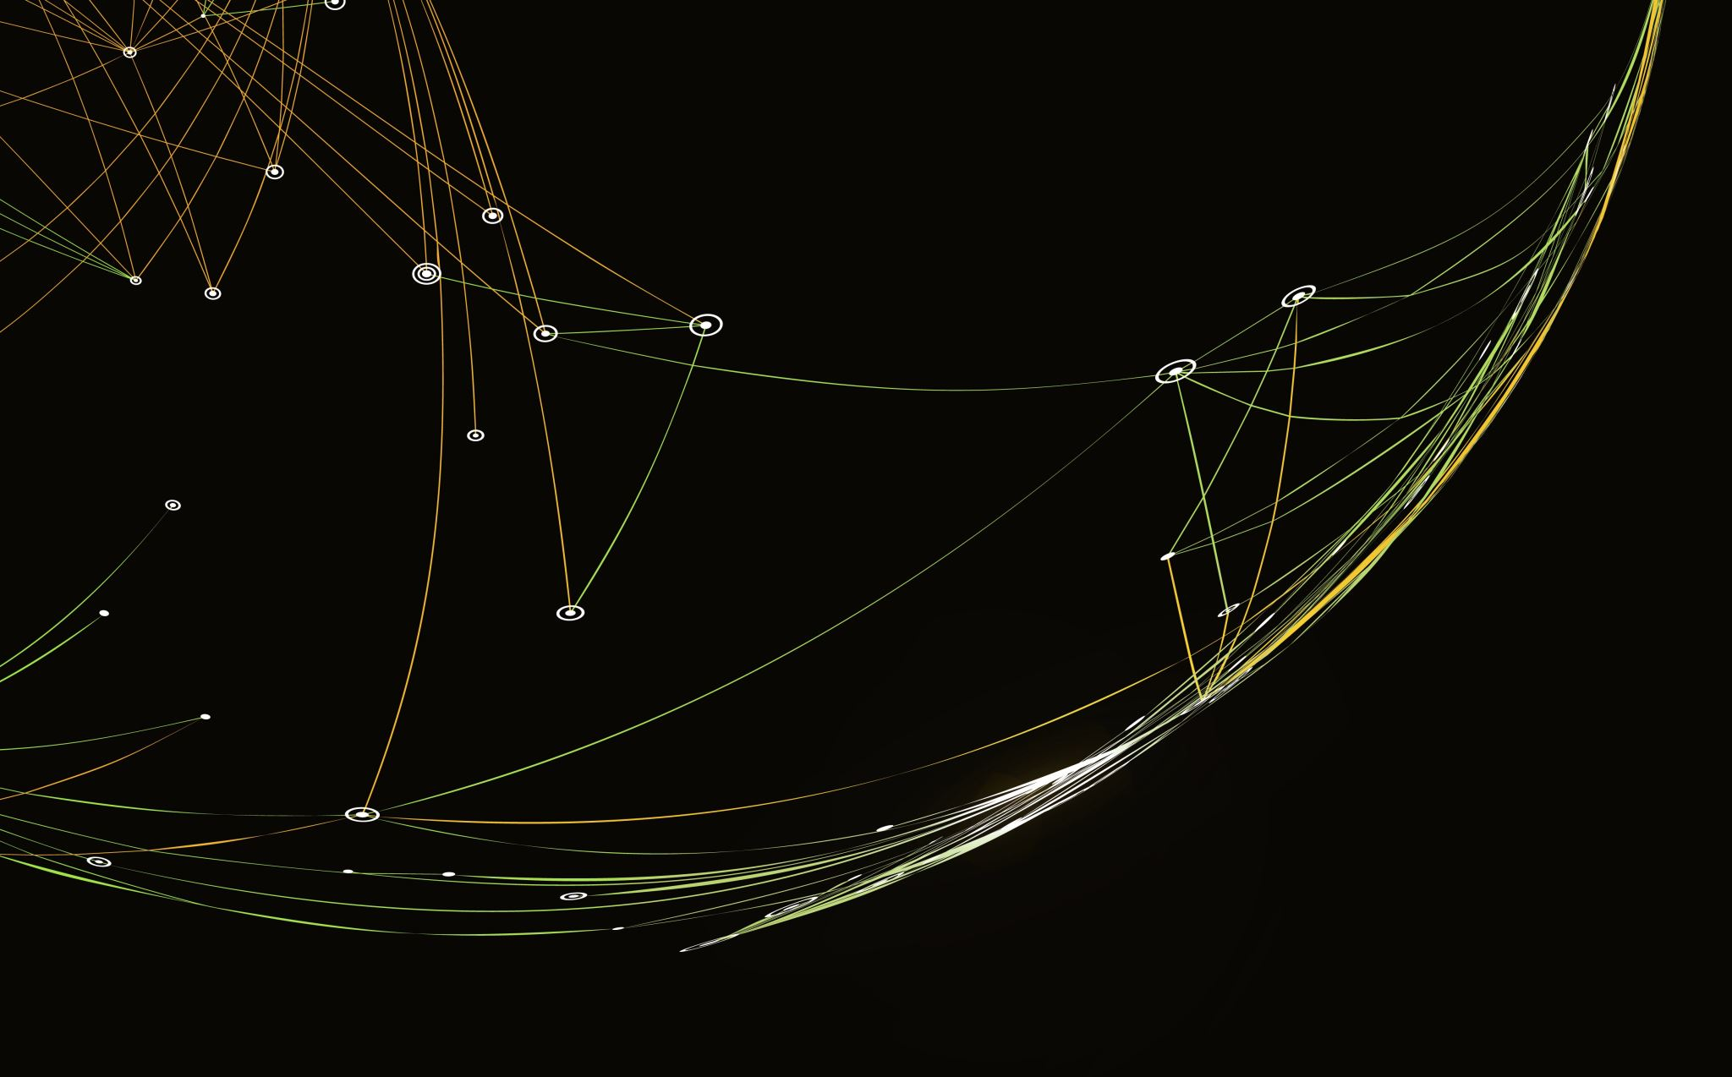
Transiting Light Curve Fitting

Slide 2
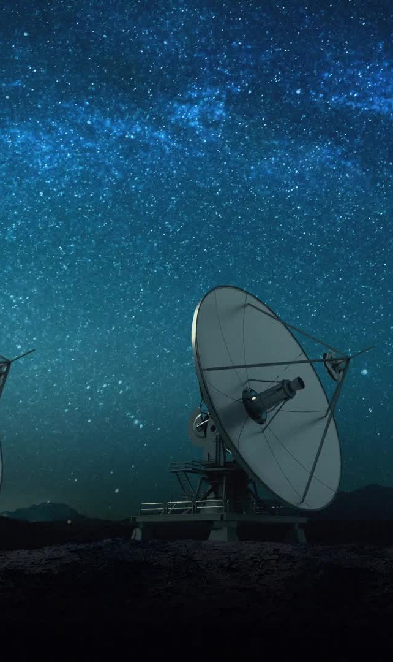
Motivation & Introduction
Detect new exoplanets that are too far for telescope to detect
Study the characteristics of exoplanets
Flux decrease as an exoplanet orbit to the back of its host star since its light be blocked by the host star
Find the best model that fit the transit lighting curve

Slide 3
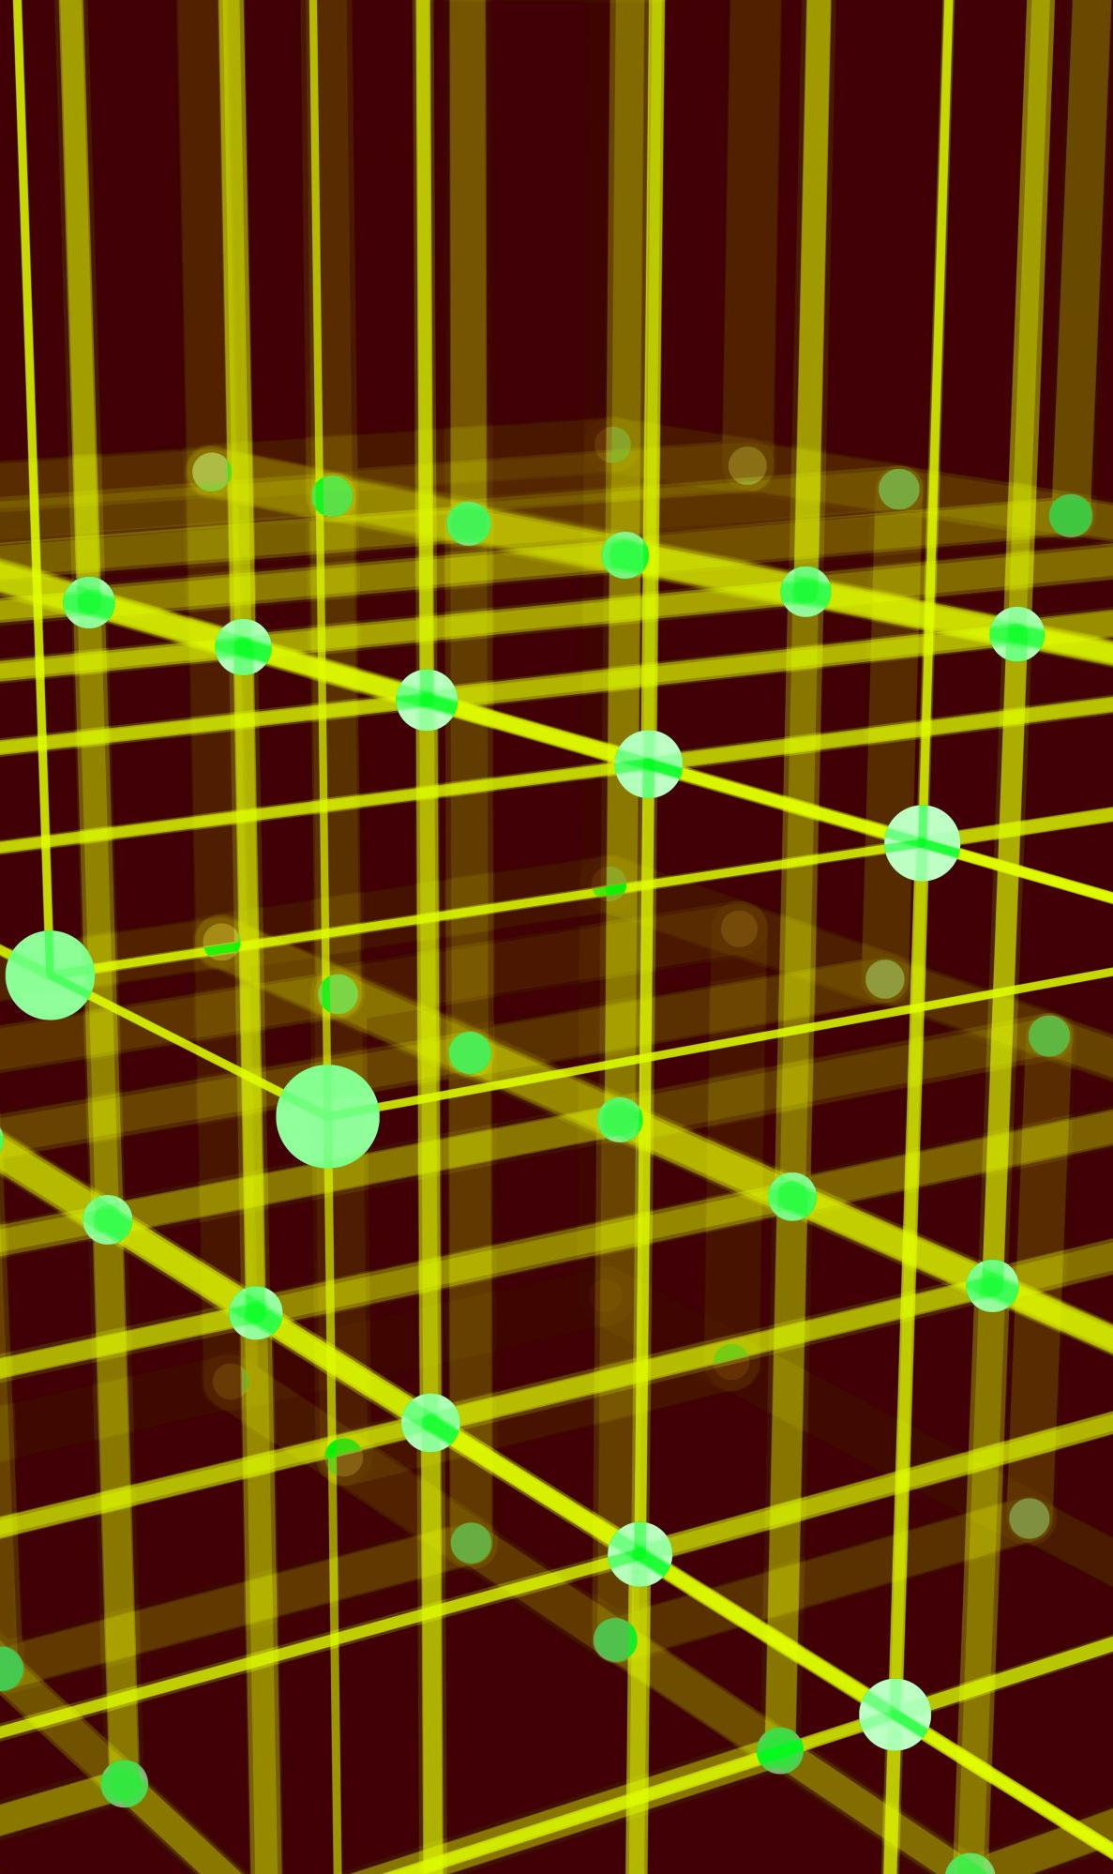

Method
Using two models to fix the transiting light curve
Box Model
Trapezoid Model
Reduced-chi square test to test how fit the models are to the curve
Smaller value indicate better fit
Using formula${ R}_{exo}= \sqrt{Depth}∗R_{host}$ to calculate the radius of exoplanet

Slide 4
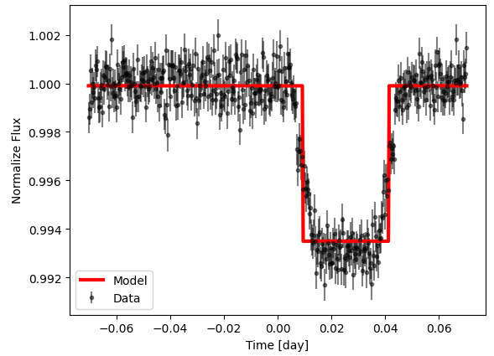
Box Model
Divide the orbit into two phases
In transit:
Distance to center less than ½ transit duration
flux = 1 – flux change – depth
Out of transit
Distance to center larger than ½ transit duration
flux = 1 – flux change
Reduce-Chi square: 2.1

Slide 5
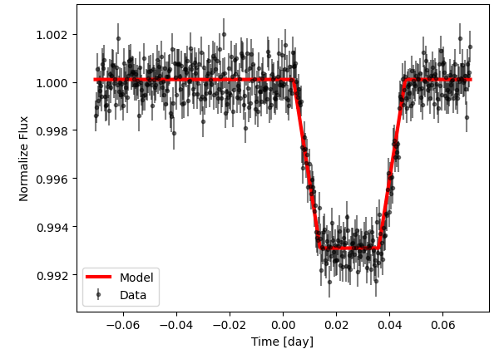
Trapezoid model
Divide the orbit into three phases
In transit:
Distance to center less than ½ transit duration
flux = 1 – flux change – depth
Ingress:
Period when the exoplanet enter the transit until it
was fully blocked
Linear relationship between flux and time
Out of transit
Distance to center larger than ½ transit duration
flux = 1 – flux change
Reduce-Chi square: 1.14

Slide 6
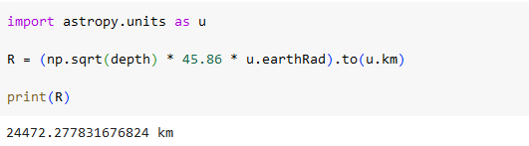
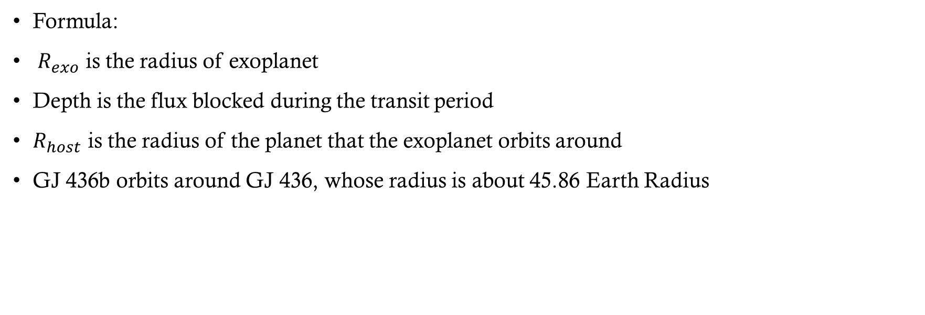
Radius calculation
$${ R}_{exo}= \sqrt{Depth}∗R_{host}$$
Formula:
${ R}_{exo}$ is the radius of exoplanet
Depth is the flux blocked during the transit period
$R_{host}$ is the radius of the planet that the exoplanet orbits around
GJ 436b orbits around GJ 436, whose radius is about 45.86 Earth Radius

Slide 7
Conclusion
Trapezoid model is a better fit model to the transit lighting curve compared to the box model
Reduced Chi Square: Trapezoid 1.14, Box model 2.1
Once the radius of the host star is known, we could get the radius of the exoplanet
Formula:
$${ R}_{exo}= \sqrt{Depth}∗R_{host}$$

